Slide 1
Common Server Types and Threats ISC FA24

Slide 2
In a broad sense, a server is a computer system that provides services to other machines over a network.
More specifically, a server is a high-performance computer that provides business services to external computers through a network. Therefore, servers require higher stability, security, and performance than common PCs.

Slide 3
Upon completion of this course, you will be able to describe:
Categories of servers
Functions of common servers
Security threats to common servers
Vulnerabilities and patches

Slide 4
Server Overview
Common Server Software
Server Security Threats
Vulnerabilities and Patches

Slide 5

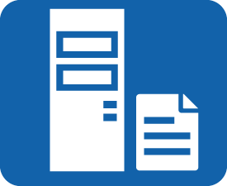



What is a Server?
A server is a high-performance computer that provides services (including query, storage, and computing) to clients over a network.
A server mainly provides services such as web application, file download, database-based storage, and printing.
Notes:
Today, servers are in wide use. Online games, websites, and most software need to be stored on servers. Some enterprises may deploy their own servers and store the most important work-related documents on hard disks of these servers.
All servers are, to put it simply, just like the computers we use from day to day, but with better stability, security, and data processing performance. Our home computers can also be used as servers if a server system is installed. However, as mentioned already, servers have high requirements on hardware stability and quality. Common computers cannot stay powered on for a long time, and important data is generally stored on servers. Therefore, common computers are not suitable for use as servers.

Slide 6
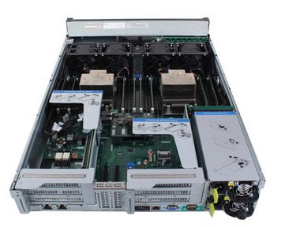
Features of a Server
Availability
Usability
Scalability
Manageability
Internal structure of a server
Notes:
Availability: A server must be reliable because it provides services to the clients on the entire network, not to the users who log in to the server. The server must not be interrupted as long as there are users on the network. In some scenarios, a server cannot be interrupted even if nobody is using the server. This is because the server must continuously provide services for users. Servers in some large enterprises, such as website servers and web servers used by public users, need to provide 24/7 services.
Usability: A server needs to provide services to multiple users and therefore requires high connection and computing performance. When using a PC, we sometimes feel it is slow. If a server has the same performance as a PC, can it be accessed by so many users at the same time? The answer is obviously no. Therefore, the performance of a server must be much higher than that of a PC. To achieve high-speed performance, a symmetric multiprocessor is installed and a large number of high-speed memory modules are inserted to improve the processing capability.
Scalability: With the continuous development of services and the increasing number of users, servers should be scalable. To ensure high scalability, a server must provide scalable space and redundant parts (such as disk array space, PCI-E slots, and memory slots).
Manageability: To ensure high reliability of services, a server must support technologies that common PCs cannot, such as two-node cluster backup, system backup, online diagnosis, and fault warning. Faults in a server should be rectified without having to shut the server down.

Slide 7
Servers vs PCs
Indicator | Servers | PCs
Processor performance | Multiprocessor supported High performance | Multiprocessor usually not supported Low performance
Availability | High | Relatively low
Usability | High | Relatively low
Scalability | High | Relatively low
Manageability | High | Relatively low

Slide 8
Server Classification
Classification Criteria | Server type
By application level | Entry-level server Work group server Department-level server Enterprise-level server
By system architecture | Non-x86 server x86 server
By appearance | Rack server Blade server Tower server Cabinet server
By usage | General-purpose server Function server
Notes:
Entry-level server: Small departments typically use an entry-level server for file and printing services. Generally, an entry-level server will suffice.
Work group server: If the application is not complex, for example, no large database needs to be managed, a work group server is usually used.
Department-level server: Department-level servers feature high availability, reliability, scalability, and manageability. They are applicable to websites and data centers of medium-sized enterprises.
Enterprise-level server: Enterprise-level servers are mainly used in large enterprises and industries with important services (such as finance, transportation, and communications), for which a large amount of data must be processed and there is a high requirement for fast processing as well as high reliability.
x86 server: A CISC server, that is, a PC server. Such a server uses Intel or other processors that are compatible with the x86 instruction set.
Non-x86 servers: include mainframe, midrange, and Unix servers. They use RISC or EPIC processors.
General-purpose server: Not designed for a specific service and can provide various service functions.
Function server: Specially designed for providing one or several functions and supports plug-and-play, eliminating the need for trained personnel to configure software and hardware.

Slide 9
Server Overview
Common Server Software
Server Security Threats
Vulnerabilities and Patches

Slide 10
Server Software
Server software works in client/server (C/S) or browser/server (B/S) mode. There are many forms of servers, including
File server
Database server
Mail server
Web server
FTP server
Domain Name System (DNS) server
Time synchronization server (NTP server)
Proxy server

Slide 11
Server Overview
Common Server Software
Server Security Threats
Vulnerabilities and Patches

Slide 12
Server Security Threats
Which security threats may affect the running of a server?
Security threats
Malicious programs
System vulnerabilities
Brute force cracking by hackers
DDoS attacks
SQL injection attacks

Slide 13



Malicious Programs
Malicious programs are usually written with attack intention.
Threats from malicious programs can be divided into two categories:
Threats dependent on host programs that cannot take effect without an application.
Independent threats in a self-contained program that can be scheduled and run by an operating system
Malicious programs include Trojan horses, worms, and viruses.
Notes:
Trojan horse: A Trojan horse is a program or command procedure that appears harmless, but is in fact malicious. It contains hidden code that, when invoked, performs an unwanted or harmful function.
Worm: A worm is a virus program that can replicate itself and send copies from computer to computer across network connections.
Virus: A virus is an aggressive program that embeds a copy of itself in other files to infect computer systems.

Slide 14


Brute Force Cracking by Hackers
If hackers fail to acquire a password by conventional means, they may use brute force to crack the password.
Brute force cracking is an exhaustive search method in which a hacker tries many combinations to obtain the password.
Password: Huawei@123
①Huawei@321 
②Huawei@213 
③Huawei@123 
Hacker
Server

Slide 15

SQL Injection Attacks
An SQL injection attack inserts malicious SQL commands into the input field of a web form or the query string of a page request to deceive the server to execute malicious SQL commands.
The commands entered are used to build (or manipulate) dynamic SQL commands or as input parameters for storage procedures. Such forms are particularly vulnerable to SQL injection attacks. For non-web CS framework systems, SQL injection risks also exist.
(1) An attacker accesses a website with SQL injection
vulnerabilities to search for an injection point.
(3) The new SQL statement is submitted
to the database.
(2) The attacker constructs an injection statement.
The injection statement and the SQL statement in the program
are combined to generate a new SQL statement.
(4) The database executes the new SQL statement,
causing an SQL injection attack.
Hacker
Website
Database

Slide 16

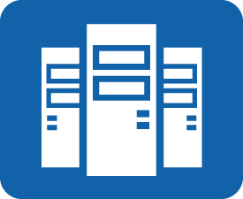
DDoS Attacks
Distributed denial of service (DDoS) attacks target large sites such as commercial companies, search engines, and government departments. A DDoS attack is launched by multiple controlled machines to a specified target. It is destructive and difficult to prevent.
Flood
Hacker
Attacked machines
Zombie hosts
Notes:
An attack that causes denial of service is called a DoS attack. A DoS attack is designed to disrupt a computer or network service.
Most DoS attacks are based on flooding a network with requests in order to disrupt its systems; however, it is difficult for individual hackers to overload high-bandwidth resources. To overcome this disadvantage, DoS attackers develop distributed denial-of-service (DDoS) attacks.
In a DDoS attack, Trojan horses are used by hackers to control other computers. More and more computers are turned into zombies and are exploited by hackers to launch attacks. Hackers utilize many zombies to initiate a large number of attack requests to the same target, and overwhelm its system. Because the requests come from multiple computers, they cannot be stopped by locating a single source.

Slide 17
Common Security Threat Defense Methods
Security Threat | Defense Method
Malicious program | Do not install suspicious software. Do not open a link from an unknown sender. Install antivirus software. Do not access suspicious websites.
Brute force cracking by hackers | Set complex passwords. Change the default port number. Disable password login, and only allow login using an authenticated secret key.
SQL injection attack | Use regular expressions to filter input parameters. Use PreparedStatement instead of Statement. Invoke this function in JavaServer Pages to check for invalid characters.
DDoS | Source authentication Fingerprint learning Domain name redirection

Slide 18
Server Overview
Common Server Software
Server Security Threats
Vulnerabilities and Patches
Overview of Vulnerabilities and Patches
Typical Vulnerability Attack Cases

Slide 19
Definition of Vulnerability
A vulnerability is a defect or weakness in the hardware, software, or protocols of computer systems or in system security policies.
In 1990, Dennis Longley and Michael Shain defined vulnerability as follows in The Data and Computer Security Dictionary of Standard, concepts, and Terms:
In computer security, a weakness in automated system security procedures, administrative controls, internal controls, etc. that could be exploited by a threat to gain unauthorized access to information or to disrupt critical processing.
Notes:
Vulnerabilities are unknown and cannot be discovered in advance.
Vulnerabilities are security risks, which may expose computers to attacks by viruses or hackers.
If a vulnerability is exploited, the consequences are unpredictable.
Vulnerabilities can be exploited remotely.
Generally, vulnerabilities can be fixed.

Slide 20
Vulnerability Hazards
Hazards
Permission bypass
Data leakage
Execution of unauthorized instructions
DoS attack
Permission escalation
Notes:
Permission bypass and permission escalation are mainly used to obtain expected data operation capabilities, for example, increasing the permissions of common users and obtaining administrator permissions.
In a DoS attack, the attacker obtains the control rights of certain services in the system to stop the services.
Data leakage is mainly caused by hackers' accessing protected data, such as reading restricted files and publishing server information.
The execution of an unauthorized instruction forces a program to execute input content as code. This obtains the access permission of the remote system or higher permissions of the local system. Examples are SQL injection and buffer overflow.
The existence of vulnerabilities is one of the necessary conditions for successful network attacks. The key to successful invasions is the early detection and exploitation of vulnerabilities in the target network system.
The security threats of vulnerabilities to network systems include escalation of common users' rights, obtaining local and remote administrator rights, local and remote DoS, server information leakage, unauthorized remote file access, reading restricted files, and spoofing.

Slide 21
Vulnerability Classification
By exploitation method: local and remote attack vulnerabilities
By location:
System security threat vulnerabilities based on the potential threats to systems and possibility of being exploited:
High-level vulnerabilities
Medium-level vulnerabilities
Low-level vulnerabilities
Operating system
Network protocol stack
Non-server program
Server program
Hardware
Communication protocol
Password recovery
Other types
Notes:
Attackers who exploit local attack vulnerabilities can be local authorized users or unauthorized users who have obtained local rights through other methods.
Attackers who exploit remote attack vulnerabilities attack remote hosts on networks.
High-level vulnerabilities can be exploited to obtain administrator permissions.
Medium-level vulnerabilities can be exploited to obtain the permissions of common users, read restricted files, and reject services.
Low-level vulnerabilities can be exploited to read unrestricted files and leak server information.
Of course, there are more vulnerability categories. For example, the status of a vulnerability can be known, unknown, and zero-day. Vulnerabilities can also be classified by user groups, such as Windows, Linux, Internet Explorer, and Oracle vulnerabilities.

Slide 22

Causes of System Vulnerabilities
Defects in software or protocol design
Bugs in software compilation
Improper system configuration
Limited security awareness
Notes:
Vulnerabilities are "inevitable". This is determined by the complexity of systems.

Slide 23
Vulnerability Scanning
Check for security vulnerabilities in the system.
Collect further target information.
Vulnerability scanning
Locate the target host or network.
Operating system detection and port scanning
Ping sweep
Notes:
Vulnerability scanning identifies security weaknesses in remote target networks or local hosts. It can be used for attack simulations and security audits.
Vulnerability scanning is a proactive measure and can effectively prevent hacker attacks. However, hackers can also use the vulnerability scanning technique to discover vulnerabilities and launch attacks.
Ping sweep checks which IP addresses are connected to live hosts.
Port scanning detects open ports on a host. Generally, a port segment or port is scanned for a specified IP address.
Operating system detection is used to determine the operating system information of the target host, and information about other computer programs being used.
Vulnerability scanning detects whether vulnerabilities exist in the target host system. Generally, scanning is performed for specified vulnerabilities on the target host.
Ping sweep determines the IP address of the target host. Port scanning identifies open ports on the target host. Operating system detection is performed based on the port scanning result, and then vulnerability scanning is conducted based on the obtained information.

Slide 24

Common Scanning Methods
Port scanning
Full connection scanning
SYN scanning
Stealth scanning
System vulnerability scanning
Passive scanning
Active scanning
Notes:
Full connection scanning: The scanning host establishes a complete connection with a specified port on the target host through a three-way TCP/IP handshake. If the port is in the listening state, the connection is successful. Otherwise, the port is unavailable.
SYN scanning: The scanner sends an SYN packet to the target host. If an RST packet is received in reply, it indicates that the port is disabled. If the response packet contains SYN and ACK, the port is in the listening state. Then, the scanner can send an RST packet to the target host, to stop the host's connection with the port.
Stealth scanning: The scanner sends a FIN packet to the target host. If the FIN packet reaches a disabled port, the packet is discarded, and an RST packet is returned. If the port is enabled, the FIN packet is simply discarded.
Passive scanning: Based on host detection. It checks inappropriate settings, weak passwords, and other objects that do not comply with security rules.
Active scanning: Based on networks. It attacks the system by executing some script files, and records the system response. In this way, vulnerabilities can be detected.

Slide 25


Definition of Patch
Now I know how to scan vulnerabilities. But how can I harden my host if vulnerabilities are found?
It's very simple. If your clothes have a hole, what should you do?
Well, I will patch them. Oh, got it. If my computer has a vulnerability, I can use a patch to fix it.
Issues with operating systems are often discovered by hackers or virus designers, or generated during the use of a system. Developers collect these errors and develop a patch. A patch is a set of changes designed to update a program and fix security vulnerabilities.
Notes:
A patch is a small piece of cloth used to mend or cover a hole in a garment or blanket. It also refers to a small program that is released to solve issues (usually discovered by hackers or virus designers) exposed during the use of a large software system (such as Microsoft operating system). Bugs cannot be avoided in software. If any bugs are found, a patch can be developed for the software and installed to fix them. Developers release patches for download on their official websites.

Slide 26
Server Overview
Common Server Software
Server Security Threats
Vulnerabilities and Patches
Overview of Vulnerabilities and Patches
Typical Vulnerability Attack Cases

Slide 27
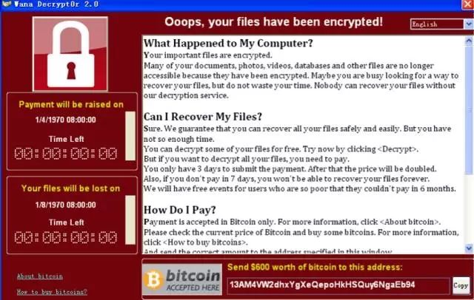
WannaCry Ransomware Attack
On May 12, 2017, the WannaCry worm that exploited the MS17-010 vulnerability spread globally and infected a large number of computers. Ransomware viruses were implanted in infected computers and encrypted a large number of files on the computers. After a victim's computer was locked by a hacker, the virus demanded the user pay $300 (USD) of Bitcoin to retrieve their files.
Notes:
WannaCry uses the vulnerabilities of port 445 in the Windows operating system to propagate and self-replicate.
After a computer is penetrated by the ransomware, many types of files in the user host system, such as photos, pictures, documents, audios, and videos, are encrypted. The file name extension of the encrypted files is changed to .WNCRY, and a ransom dialog box is displayed on the desktop, asking the victim to pay $300 (USD) of Bitcoin to the attacker's bitcoin wallet. The ransom increases over time.

Slide 28

DROWN Vulnerability
In March 2016, a new security vulnerability, DROWN, was found in the open source encryption tool OpenSSL used by about two-thirds of the world's website servers.
The vulnerability allowed hackers to attack websites and read encrypted information such as passwords, credit card accounts, business secrets, and financial data. This was a huge security challenge for global websites. More than 100,000 websites in China were affected.
Notes:
Users must periodically scan their computers, upgrade software to the latest versions, check software configurations, disable insecure options, and pay attention to the recommendations of security companies. These are effective means to avoid vulnerabilities.

Slide 29

How Do You Defend Against These Vulnerabilities?
How to implement these defenses?
Disable specific ports or services
Improve security awareness
Scan and kill viruses and Trojan horses in a timely manner
Update system patches promptly

Slide 31
Host Firewalls and Antivirus Software

Slide 32
Firewalls were first applied to buildings to isolate fire and prevent fire from spreading from one area to another.
In the communications field, firewalls are mainly used to protect a network against attacks and intrusions from other networks.
Antivirus software is a type of program tool that is used to remove known harmful program code, such as viruses and Trojan horses, from computers.

Slide 33
Upon completion of this course, you will be able to:
Describe the definition and categories of firewalls.
Describe the main functions of firewalls.
Describe the concept of antivirus software.
Distinguish antivirus software from firewalls.

Slide 34
Firewall Overview
Windows Firewalls
Linux Firewalls
Antivirus Software

Slide 35

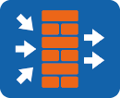


What Is a Firewall?
A firewall is a method of separating private networks from public networks (such as the Internet). It is actually an isolation technology. A firewall allows only authorized people and data to access a network and prevents access from hackers. If data fails to pass through a firewall, people on an intranet cannot access the Internet, and people on the Internet cannot communicate with people on the intranet.
Notes:
The firewall technology is a specific security technology. The term “firewall” was originally used to describe the wall built between buildings to prevent fire from spreading.
Firewall = Hardware + Software + Control policies
Control policies:
Permit unless otherwise specified
Deny unless otherwise specified

Slide 36
Firewall Classification
By form:
Hardware firewalls
Software firewalls
By protected object:
Standalone firewalls
Network firewalls
Notes:
Hardware firewall: uses an embedded system, which is generally open-source. Hardware firewalls are used to isolate internal and external networks through a combination of hardware and software.
Software firewall: is generally installed on an OS platform. A software firewall isolates internal and external networks by means of software.
Standalone firewall: serves only the current host.
Network firewall: serves a specific network.

Slide 37
Windows Firewalls
A Windows firewall is a software firewall built in the Windows OS.
Built-in

Slide 38
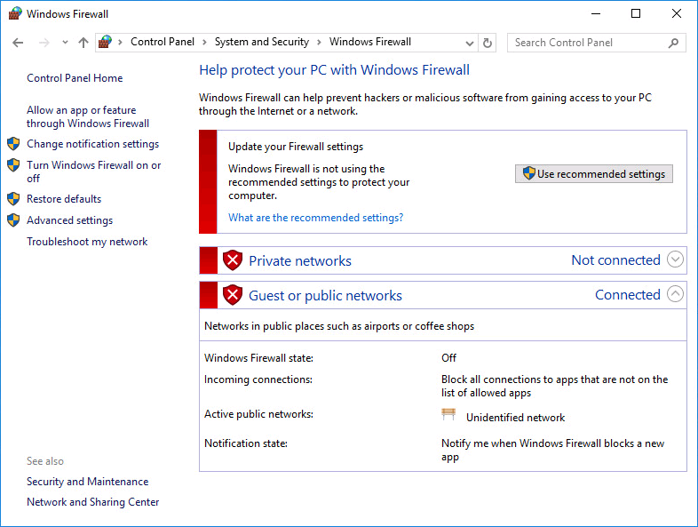
Windows Firewall Settings
Notes:
Allow an app or feature through Windows Firewall: specifies a data pass-through rule.
Change notification settings: specifies a notification rule.
Turn Windows Firewall on or off: enables or disables the Windows firewall.
Advanced settings: specifies detailed inbound & outbound rules and connection security rules.
Restore defaults: restores the Windows firewall to its default settings.
Troubleshoot my network: detects network issues.

Slide 39
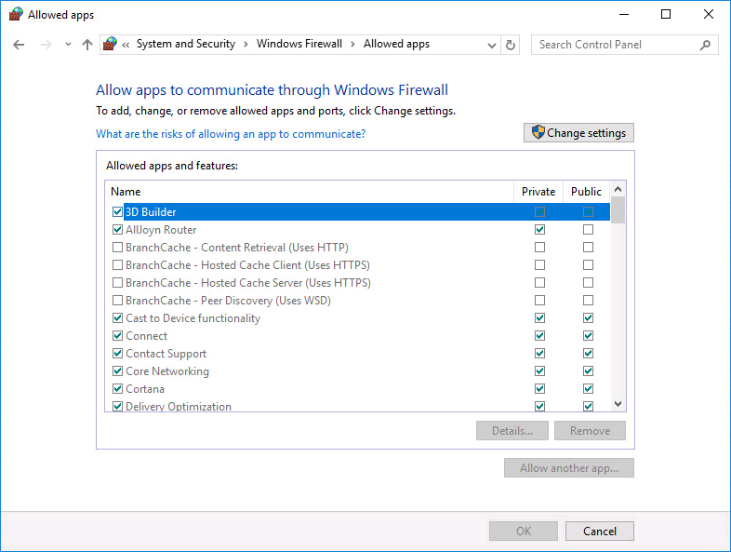
Windows Firewall Rule Settings
Allow an app or feature through the Windows firewall.
Notes:
Change settings: adds, changes, or removes allowed apps and ports.
Details: displays the details of allowed apps and features.
Remove: removes apps or features from Allowed apps and features.
Allow another app: adds an app or feature to Allowed apps and features.
You can select apps and features from Allowed apps and features and apply them to a home/work (dedicated) network or a public network.

Slide 40
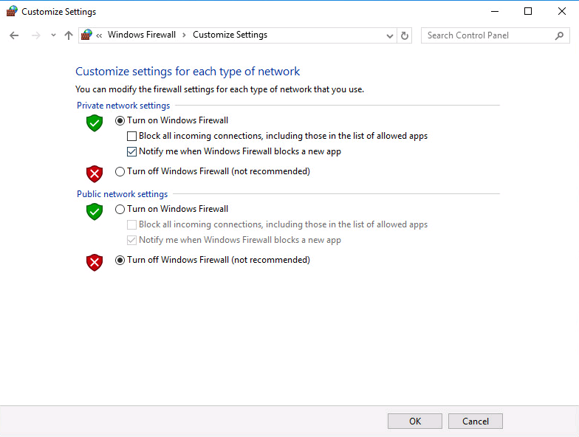
Windows Firewall Notification Rule
Modify a notification rule.
Notes:
When a Windows firewall is enabled, you can determine whether to send a notification when the firewall blocks new apps.

Slide 41
Enabling or Disabling a Windows Firewall
Notes:
Enable the firewall for a type of network for security protection, or disable the firewall so that all apps can pass through.
The window for enabling or disabling change notification is the same as that for enabling or disabling the Windows firewall.

Slide 42
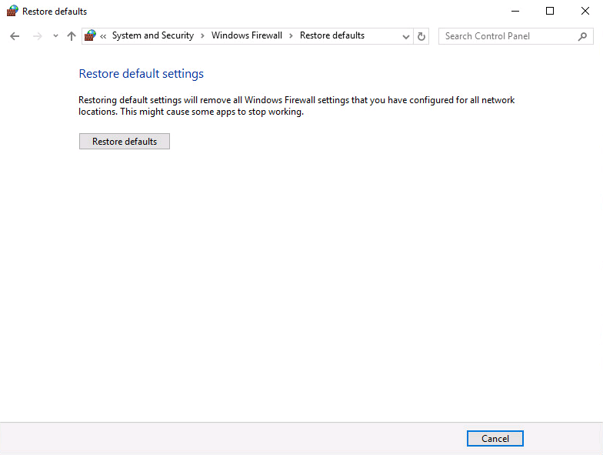
Initializing Windows Firewall Settings
Restore default settings.
Notes:
If firewall rules are not set properly, malicious network attacks may not be blocked, and users may fail to access the Internet. If such a situation occurs, click Restore defaults to restore the Windows firewall to the default settings.

Slide 43
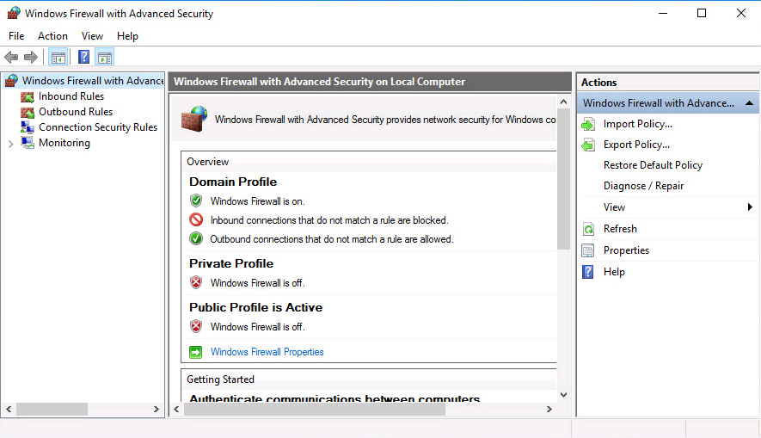
Advanced Windows Firewall Settings
Notes:
If settings of Allow an app or feature to through Windows Firewall cannot meet your requirements, you can access the Windows Firewall with Advanced Security window to set more detailed rules.
Settings in this window allow you to customize inbound rules, outbound rules, and connection security rules, and monitor the firewall.

Slide 44
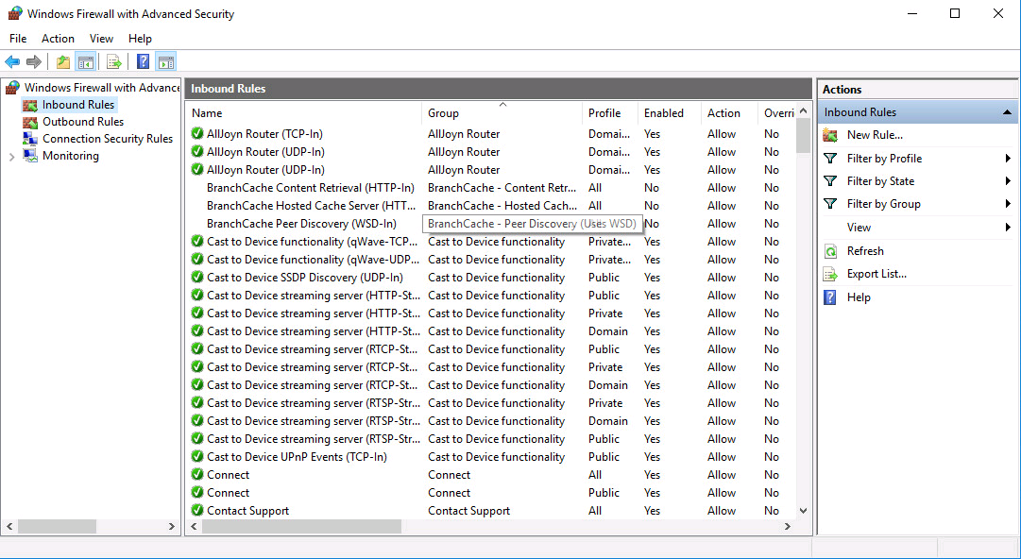
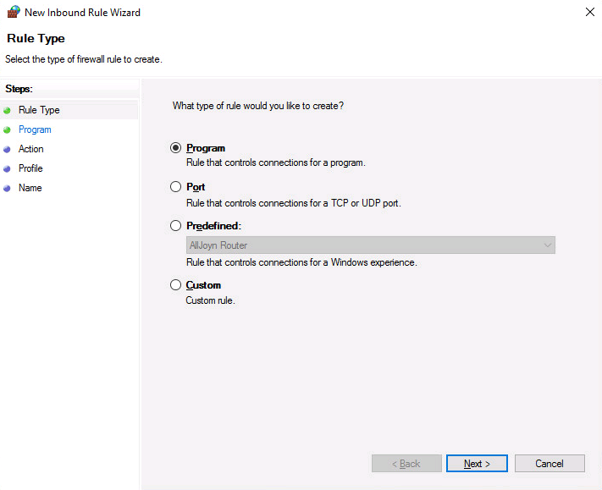
Windows Firewall Rule Settings
Notes:
Program: specifies a rule that controls connections for specific local programs or all programs when they use public (or home) networks.
Port: specifies a rule that controls connections for specific local ports or all ports when they use public (or home) networks.
Predefined: specifies a predefined rule that controls connections.
Custom: specifies a rule that controls connections for specific local programs when they use public (or home) networks through predetermined source and destination ports and IP addresses.

Slide 45
Firewall Overview
Windows Firewalls
Linux Firewalls
Antivirus Software

Slide 46
Iptables Introduction
Iptables is a free packet filtering firewall. It evolves along with the development of the Linux kernel, and has undergone four phases:
1.1 kernel: ipfirewall
2.0 kernel: ipfwadm
2.2 kernel: ipchains
2.4 kernel: iptables
Notes:
A Linux firewall consists of two components: netfilter and iptables. Iptables is an interface between a firewall and users, while netfilter provides firewall functions.
netfilter is a framework in the Linux kernel. It provides a series of tables. Each table consists of several chains, and each chain consists of several rules.
Iptables is a user-level tool which can add, delete, and insert rules. These rules tell the netfilter component how to process data packets.

Slide 47
Iptables Structure
Iptables structure: iptables > table > chain > rule. A table consists of chains, and a chain consists of rules, as shown in the following figure.
Table 1
Table 2
Chain 1
Chain 2
Chain 1
Chain 2
Rule 1
Rule 2
Rule 3
Rule 1
Rule 2
Rule 3
Rule 1
Rule 2
Rule 3
Rule 1
Rule 2
Rule 3

Slide 48
Basic Concepts of Iptables - Rule
If a data packet matches a rule, the packet is processed according to the rule.
An iptables rule specifies quintuple information including the source address, destination address, source port, destination port, and protocol.
If a data packet matches an iptables rule, iptables processes the packet according to the method defined in the rule, for example, allowing the packet to pass through or discarding the packet.
Rule
Source address: 192.168.1.1
Destination address: any
Protocol: HTTP
Action: permit
192.168.1.2

Slide 49
Basic Concepts of Iptables - Chain
A chain is a path for transmitting data packets. Each chain contains one or more rules. When a data packet reaches a chain, iptables matches the packet with the first rule in the chain and checks whether the packet meets the conditions defined in the rule.
If yes, iptables processes the packet according to the action defined in the rule. If no, iptables matches the packet with the next rule.
If the packet does not match any rule in the chain, the default policy in the chain is used.
Chain
Rule 1 Source address: 192.168.1.1 Destination address: any Protocol: HTTP Action: permit
Rule 2 Source address: 192.168.1.2 Destination address: any Protocol: DNS Action: permit
Rule 3 Source address: 192.168.1.3 Destination address: any Protocol: ICMP Action: deny
Rule 4 Source address: 192.168.1.4 Destination address: any Protocol: ARP Action: deny
Rule 5 Source address: 192.168.1.5 Destination address: any Protocol: IGMP Action: deny
Notes:
Iptables contains five rule chains:
PREROUTING
INPUT
FORWARD
OUTPUT
POSTROUTING
These are the five rule chains defined by netfilter. Any data packet passing through will reach one of these chains.

Slide 50
Basic Concepts of Iptables - Table
Tables provide specific functions. Iptables contains four tables:
filter table: permits or denies data packets.
nat table: translates addresses.
mangle table: modifies packet data.
raw table: determines whether data packets are processed using the state tracking mechanism.
Table priority: raw > mangle > nat > filter.
Notes:
Generally, three chains are allowed in a filter table: INPUT, FORWARD, and OUTPUT.
Generally, three chains are allowed in a nat table: PREROUTING, OUTPUT, and POSTROUTING.
All the five chains are allowed in a mangle table: PREROUTING, INPUT, FORWARD, OUTPUT, and POSTROUTING.

Slide 51
Process of Transmitting Data Packets by Iptables
Inbound data packets
Outbound data packets
PREROUTING chain
FORWARD chain
POSTROUTING chain
INPUT chain
Internal processing
OUTPUT chain
Notes:
When a data packet enters a network adapter, it is first matched with the PREROUTING chain. The system determines the subsequent processing according to the destination address of the packet. Possible processing:
If the destination address of the packet is the local host, the system sends the packet to the INPUT chain to match the packet with rules in this chain. If the packet matches a rule, the system sends the packet to the corresponding local process. If no match is found, the system discards the packet.
If the destination address of the packet is not the local host, the packet will be forwarded. The system directly sends the packet to the FORWARD chain to match the packet with rules in this chain. If the packet matches a rule, the system sends the packet to the corresponding local process. If no match is found, the system discards the packet.
If the packet is locally generated, the system directly sends the packet to the OUTPUT chain to match the packet with rules in this chain. If the packet matches a rule, the system sends the packet to the corresponding local process. If no match is found, the system discards the packet.

Slide 52
Iptables Rules
Iptables rules are complex.
Format: iptables [-t table] COMMAND chain CRITERIA -j ACTION
-t table: specifies the table to which the rule applies. It can be filter, nat, mangle, or raw.
COMMAND: defines how to manage rules.
chain: specifies a chain, and can be omitted when you define a policy.
CRITERIA: specifies matching criteria.
-j ACTION: specifies the action to be taken.
For example, access to 172.16.0.0/16 is not allowed.
iptables -t filter -A INPUT -s 172.16.0.0/16 -p udp --dport 53 -j DROP

Slide 53
Firewall Overview
Antivirus Software

Slide 54
What Is Antivirus Software?
Antivirus software is a type of software used to remove computer viruses, malicious software, Trojan horses, and other computer threats.
Antivirus software provides functions such as monitoring, identification, virus scanning, virus clearing, automatic upgrade, and proactive defense.

Slide 55
Basic Functions of Antivirus Software
Virus prevention: prevents viruses from attacking computers.
Virus identification: scans for viruses in the programs or files running on a computer and compares the viruses against the virus signature database to identify them.
Virus clearing: restores infected objects according to different types of viruses and their infection characteristics.

Slide 56
Antivirus Software Components
Antivirus software consists of scanners, a virus signature database, and a VM, which are integrated by a main program.
Antivirus software
Scanning component 1
Scanning component 2
Virus signature database
Virus signature database
Scanner 1
Scanner 2
Scanner 1
VM
Scanner 3
Scanner 4
Scanner 2
Scanner
Notes:
Scanners are the main part of antivirus software and are mainly used to scan viruses. The antivirus effect of antivirus software depends on how advanced the scanner compilation technology and algorithm are. Therefore, most antivirus software has more than one scanner.
The virus signature database stores virus signatures, which are classified into memory signatures and file signatures. Generally, file signatures exist in files that are not executed. Memory signatures generally exist in a running application program.
A VM enables viruses to be run in a virtual environment built by antivirus software.

Slide 57
Key Technologies of Antivirus Software - Unpacking
The unpacking technology is commonly used by antivirus software. This technology can be used to analyze compressed files, files with misleading instructions, and packed files.
Variant virus B
Variant virus A
Virus
Virus
Shell A
Shell B
Antivirus software without unpacking capability
Unpacking engine | Virus
Shell virus
Antivirus software with unpacking capability
Notes:
If antivirus software does not have a strong unpacking capability, two different signature records must be added to defend against shell viruses. This is because if a hacker uses another tool to pack a virus, the virus will not be recognized by the antivirus software, and a new signature record must be added for removing the virus.
If antivirus software has a strong unpacking capability, it unpacks the virus file, and then scans and kills the virus. In this way, only one signature record is enough. This reduces the occupation of system resources by the antivirus software, and greatly improves the antivirus software's capability to scan and kill viruses.

Slide 58
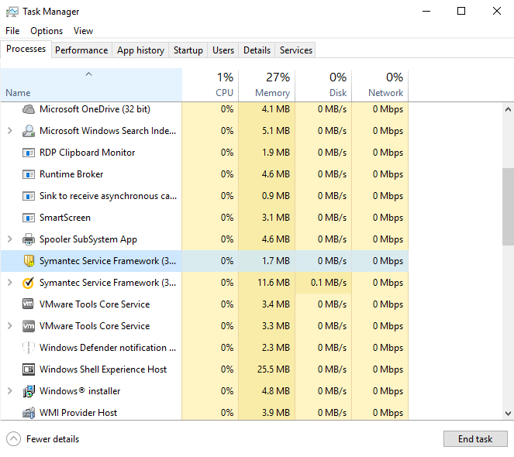
Key Technologies of Antivirus Software - Self- protection
The self-protection technology prevents viruses from ending the running process of antivirus software or tampering with antivirus software files.

Slide 59
Key Technologies of Antivirus Software - Repair
Antivirus software usually deletes infected files to remove viruses. In this case, some system files may be deleted by mistake. As a result, the system breaks down and cannot start. The repair technology of antivirus software repairs damaged files.

Slide 60
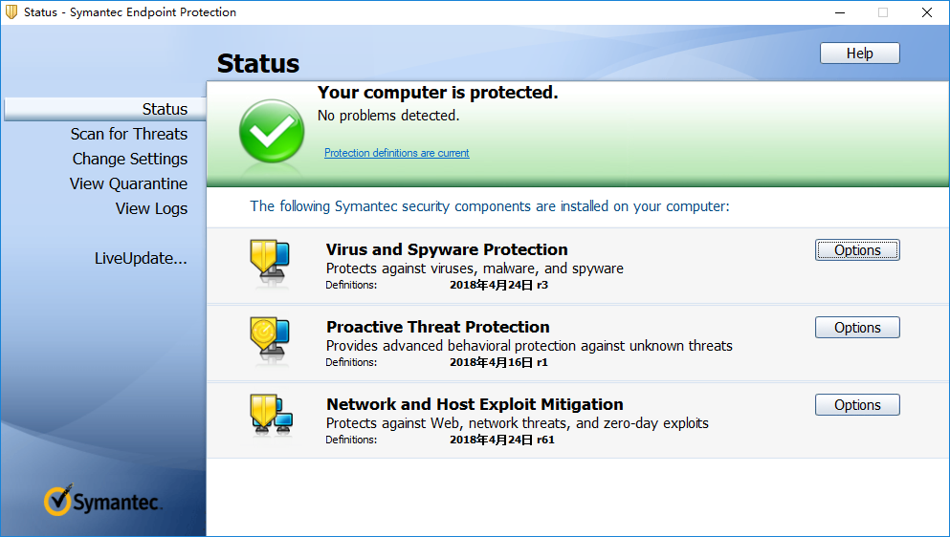
Key Technologies of Antivirus Software - Real-Time Update
The virus signature database of antivirus software is usually lagged behind computer viruses. Therefore, the real-time update of the virus signature database is particularly important.
Notes:
Currently, a more advanced cloud antivirus technology can be used to access the virus signature database on the cloud in real time. Users do not need to update their local virus signature database frequently.

Slide 61
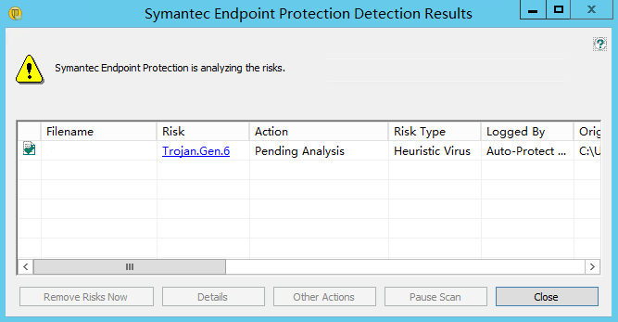
Key Technologies of Antivirus Software - Proactive Defense
Antivirus software can also monitor program actions and files to automatically detect viruses and perform proactive defense.

Slide 62
Mainstream Antivirus Software in China
Rising
Symantec
Kaspersky
Jiangmin
Kingsoft
McAfee
360

Slide 63
What Antivirus Software Do Users Need?
Occupied resources
Antivirus speed
UI
Antivirus effect

Slide 64
Common Knowledge of Antivirus Software
Antivirus software cannot scan or kill all viruses.
Antivirus software cannot kill all scanned viruses.
It is unnecessary to install two or more sets of antivirus software on one OS of a computer (unless for compatible or green versions), although many types of antivirus software are compatible. In addition, you are advised to view the list of incompatible programs.
Antivirus software may clear, delete, forbid access to, or isolate infected files. It also may not process the files.
Notes:
Clear: Clear worms from infected files to restore the files.
Delete: Delete virus files. These files are not infected but contain viruses. They cannot be cleared.
Forbid access: Do not access virus files. After a virus file is detected, if you choose not to process the file, the antivirus software may deny access to this file. When you attempt to open such a file, an error message "not a valid win32 application" is displayed.
Isolate: After a virus file is deleted, the file is moved to the isolation area. You can retrieve deleted files from the isolation area. Files in the isolation area cannot run.
No process: If you are not sure whether a file contains viruses, do not process it temporarily.
Most antivirus software is lagged behind computer viruses. In addition to updating antivirus software in a timely manner and periodically scanning your computer: update your computer and network security knowledge, do not open unknown files or insecure web pages, update your password as required, and use the security assistant and personal firewall. These measures will better protect your computer and network security.

Slide 65
Server Overview
Common Server Software
Server Security Threats
Vulnerabilities and Patches

